Slide 1


Smart parking Project

Slide 2
Plan
Introduction
Graphic chart
Business feasibility study
Technical feasibility study
App Prototype

Slide 3
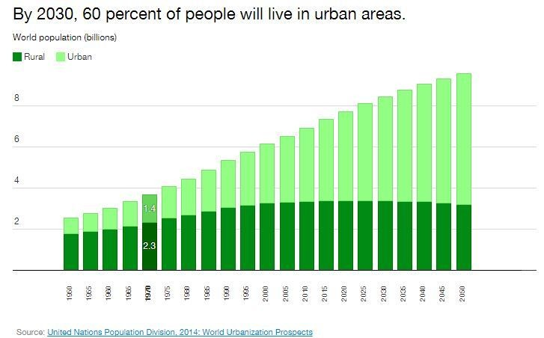
Introduction

Slide 4
Graphic
Chart

Slide 5
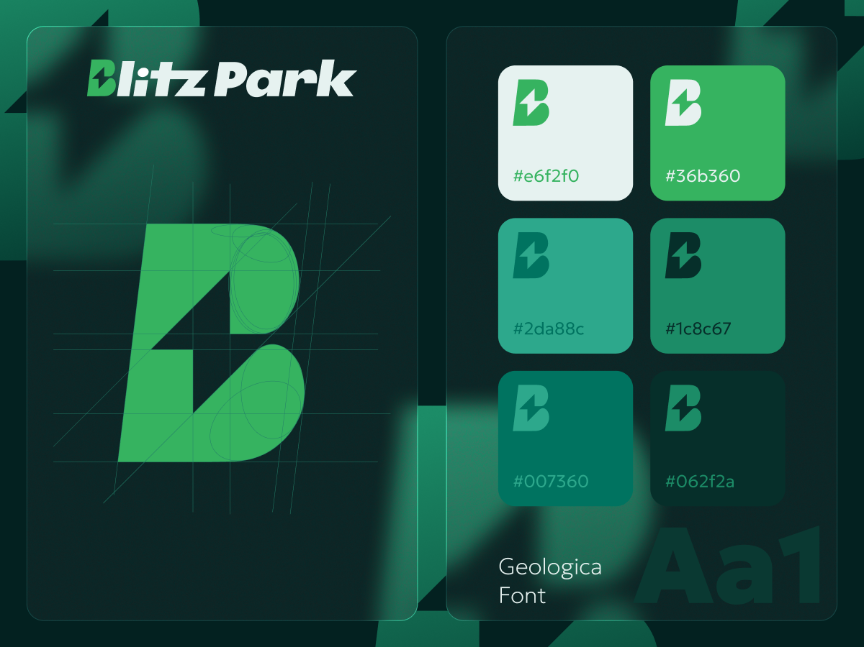

Slide 6
Technical
Fesability

Slide 7
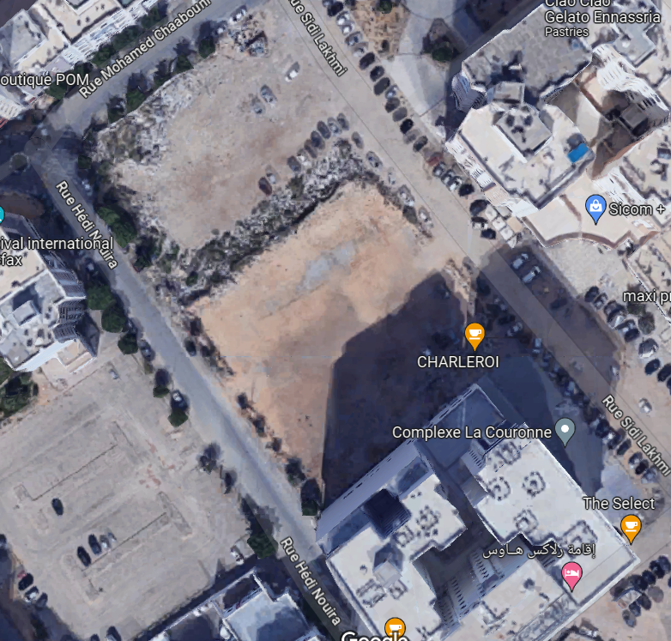
Technical Fesability
The list of materials are broadly available in the market.
the chosen spot for the park is in the center of the city which means plenty of demand for parking spots.

Slide 8
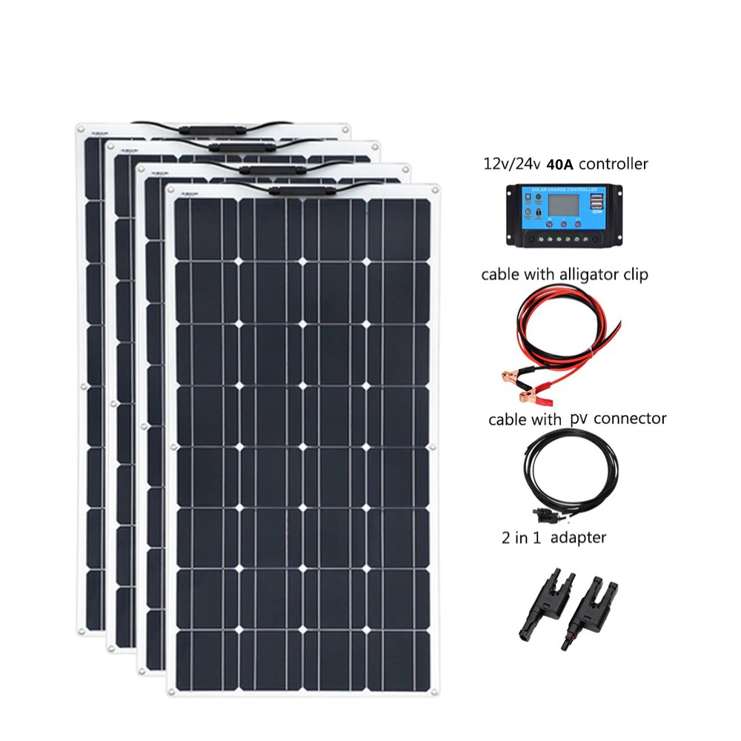
Kit Panneau solaire souple 400W avec contrôleur
400W Flexible Solar Panel Kit with Controller is the best quality solar panel we have found on a comparative market with excellent performance, even in low sunlight. It is eye-resistant enough to create a single treatment panel that is practical enough.
Costs : 2 750dt

Slide 9
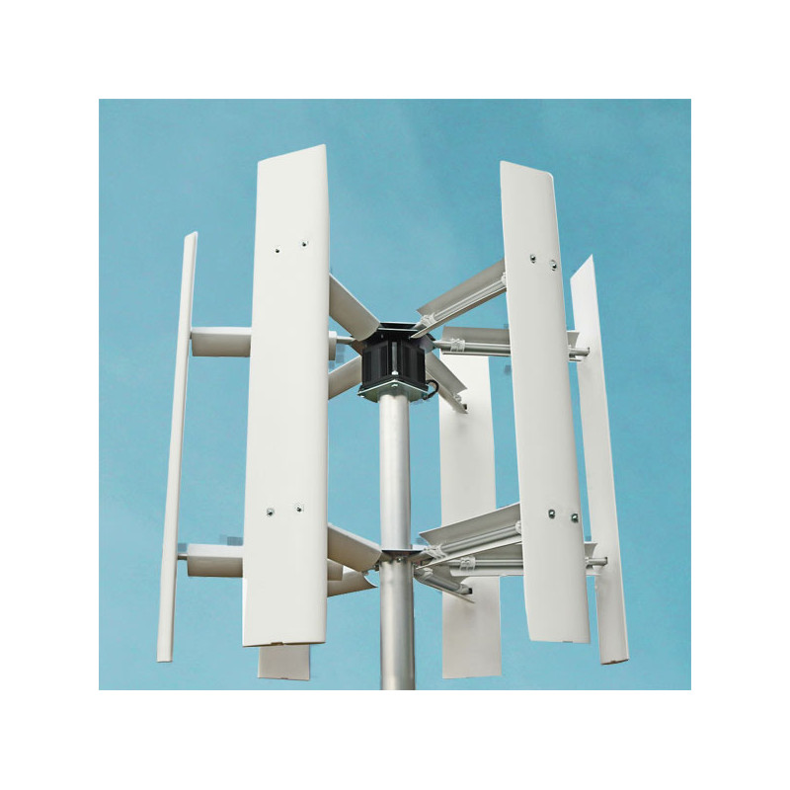
Wind turbine 3KW PRO 6 blades
3KW wind turbine with 6 horizontal blades, brushless alternator, 100A three-phase rectifier, 60A controller and a 3200W converter
Prix :11 000dt

Slide 10
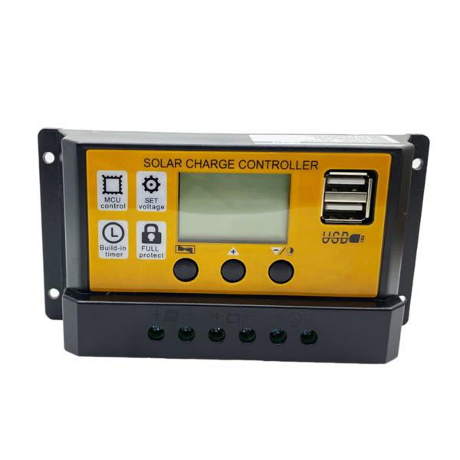
MPPT solar charge controller 12V/24V 20A
Current autofocus MPPT tracking charging, high charging efficiency, charging process does not stop detection, two-way focus tracking. The minute is adjustable when the output is off, which is more convenient (there is no adjustment when the market is only available). Built-in over temperature, over current, short circuit, open circuit protection, fault clearance, controller automatic recovery Two-way MOS tube anti-backflow circuit, high-power charging mode, ultra-low heat.
Price: 58dt

Slide 11
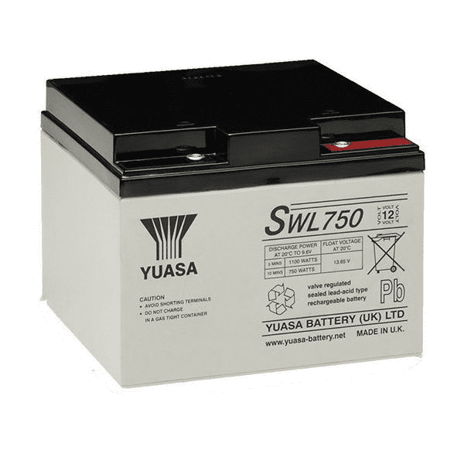
Rechargeable battery 12V 22.9Ah SWL750
Yuasa SWL750 (12V 22.9Ah) General Purpose VRLA Battery – 10 Hour Capacity (Ah) is a high quality rechargeable sealed lead acid battery designed to provide excellent performance, durability and long life. This battery meets or exceeds the original manufacturer's specifications. The SWL750 replacement battery is backed by our industry-leading 1-year replacement warranty. An extended warranty of up to 3 years is available for your convenience. Our warranty includes shipping and is hassle-free, the only warranty of its kind on the market.
Price: 250dt

Slide 12
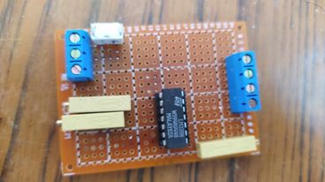
Main circuit board
The board employs two TL082 ICs and four adjustable resistors to monitor battery voltage levels. When the voltage exceeds preset thresholds determined by the resistors, the TL082 comparators are triggered. The battery levels are then shown on the dashboard's graphical interface. The board has six pins, with two connecting to the battery, one supplying power to the Raspberry Pi, and three sending input signals to it for display.

Slide 13
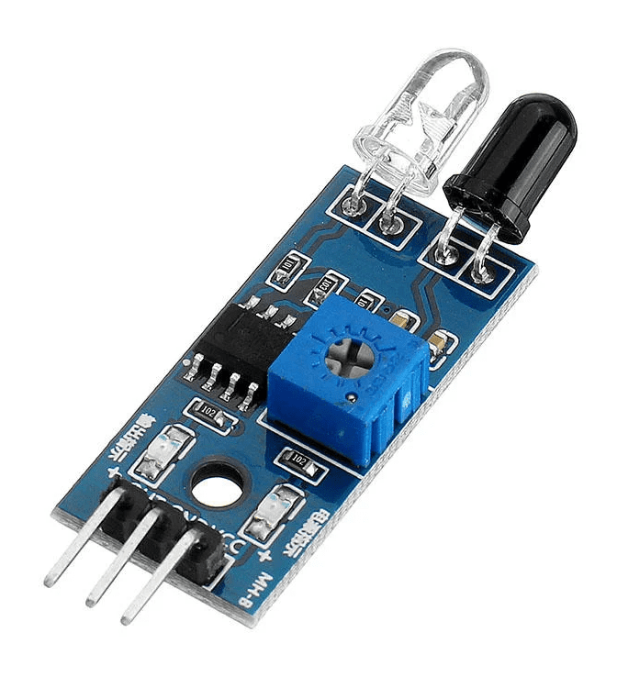
FC-51 Infrared Obstacle Avoidance Sensor
FC-51 Infrared Obstacle Avoidance Sensor , Infrared Obstacle Avoidance Sensor (Active Low) includes a pair of infrared transmitting and receiving tubes. When the transmitted light waves are reflected, the reflected infrared waves will be received by the receiver tube. The built-in comparator circuit performs processing, and the green light turns on.
Price: 0.45dt

Slide 14
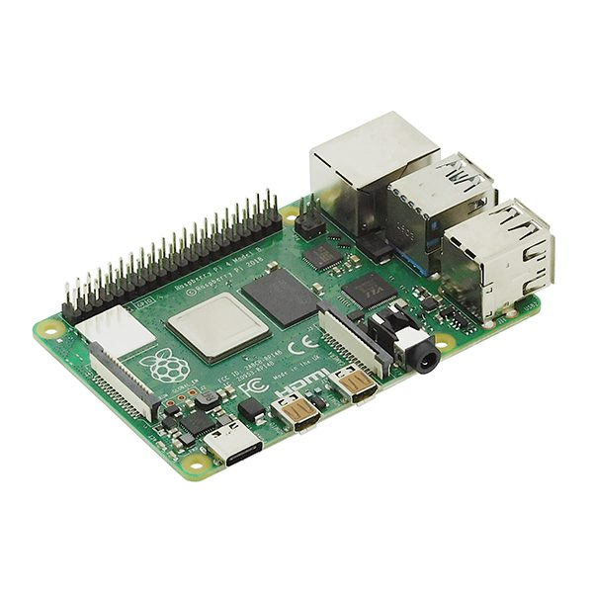
Raspberry Pi4 2GB RAM board
Raspberry Rpi 4 RAM 2GB Card is the latest product in the popular Raspberry Pi line of computers. It offers revolutionary increases in processor speed, multimedia performance, memory and connectivity compared to the Raspberry Pi 3 Model B+ previous generation while maintaining backward compatibility and similar power consumption. For the end user, Raspberry Pi 4 Model B delivers desktop performance comparable to entry-level x86 PC systems.
Price: 300dt

Slide 15
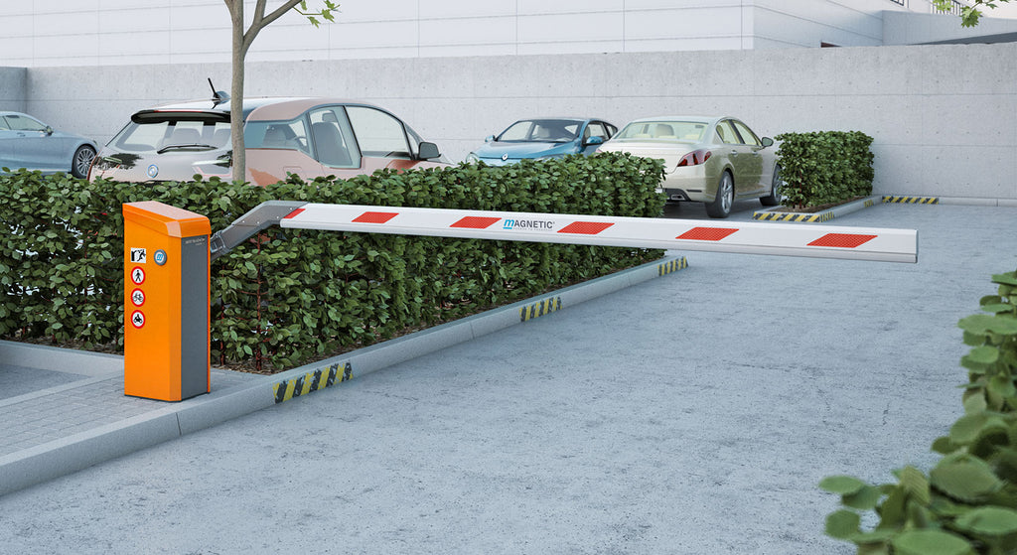
Straight Bar Barrier Gate
Product Introduction
Vehicle entrance control gate barrie
Compact design
Switchable Reader Panel
Simple installation
Long life cycle
Price: 1000dt

Slide 16
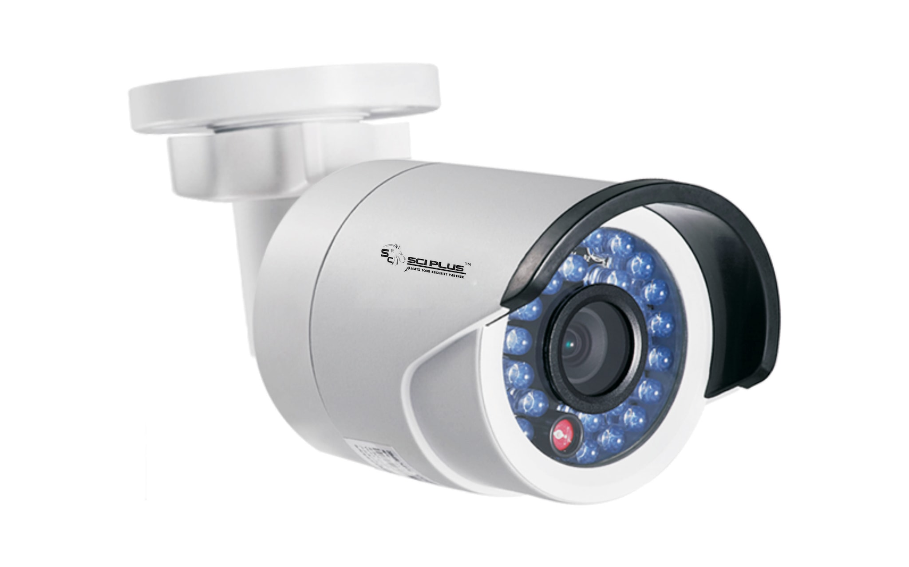
Camera solutions
Installed for to monitor and survey the parking lot area.
Price: 2000dt

Slide 17
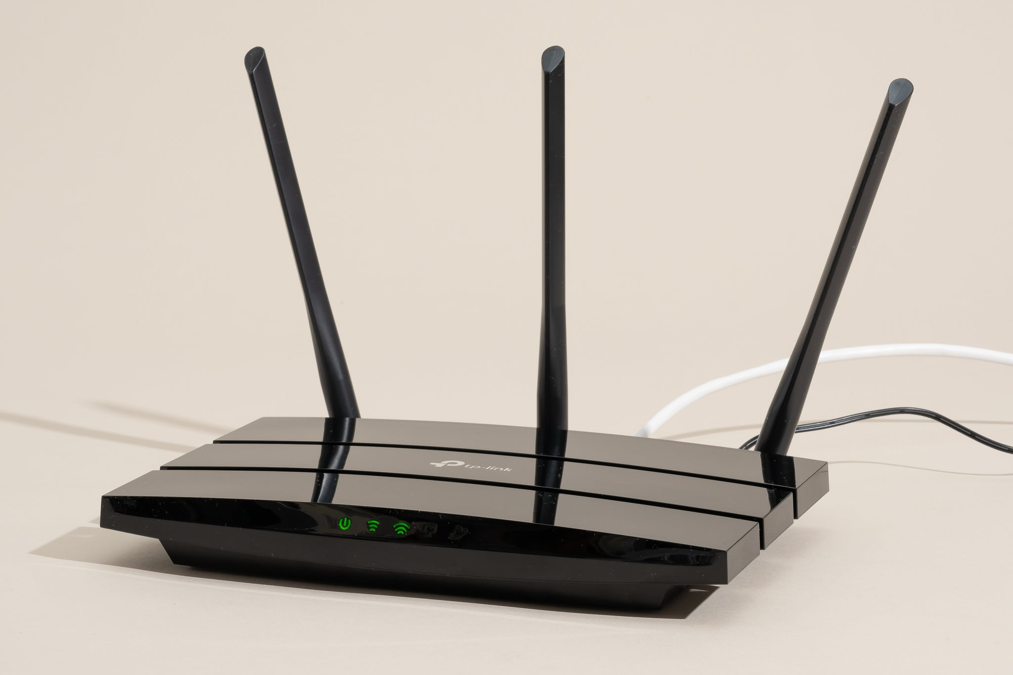
Internet Connection
A necessity for our IoT system infrastructure

Slide 18
Financial Feasibility

Slide 19
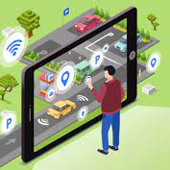
THE SMART PARKING ALLOWS:
serenity and coexistence
Efficiency and profitability through data collection and analysis
Save time thanks to the routing list
EnergySaving

Slide 20
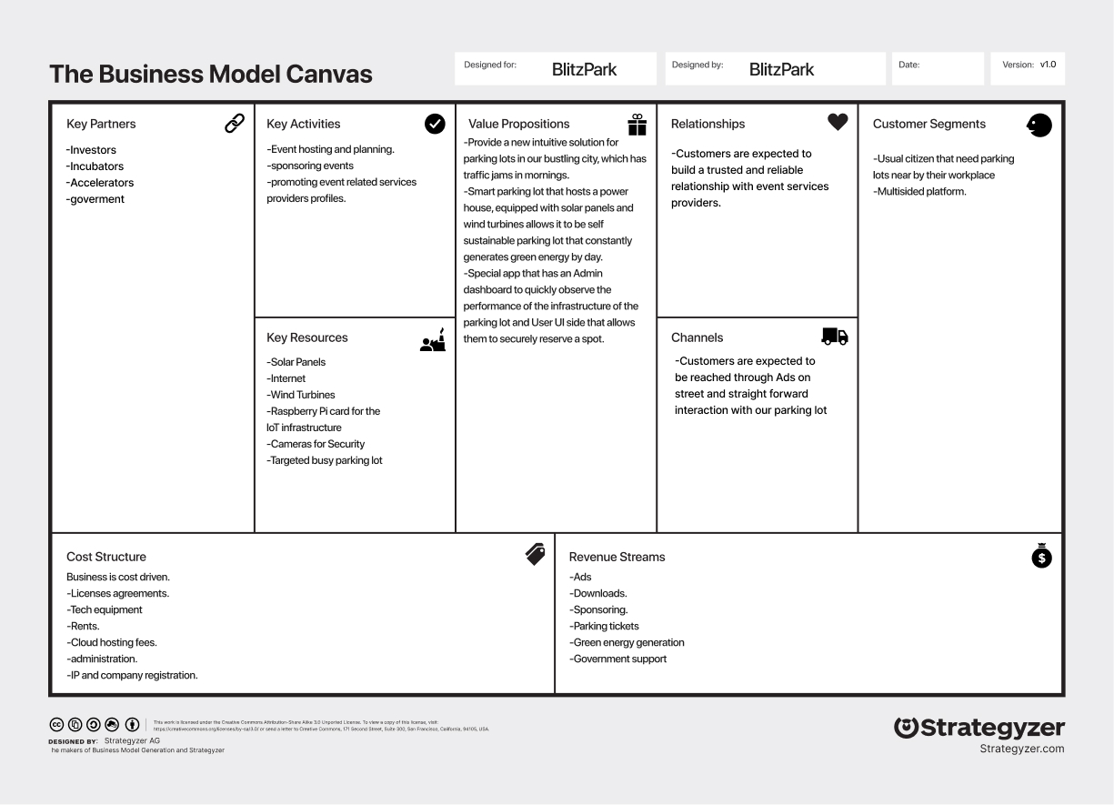
BMC

Slide 21
Costs breakdown
Name | Quantity | Price | Total
Solar Panel | 4 | 2 750 | 11 000
Wind Turbine | 2 | 11 000 | 22 000
MPPT solar charge controller | 1 | 58 | 58
battery | 5 | 250 | 1 250
FC-51 Infrared Obstacle Avoidance Sensor | 75 | 0,45 | 33,750
Raspberry Pi4 2GB RAM board | 1 | 280 | 280
Straight Bar Barrier Gate | 2 | 1 000 | 1 000
Camera solutions | 1 | 2 000 | 2 000

Slide 22
Total Spending
37 621,75 TND

Slide 23
App Prototype

Slide 24

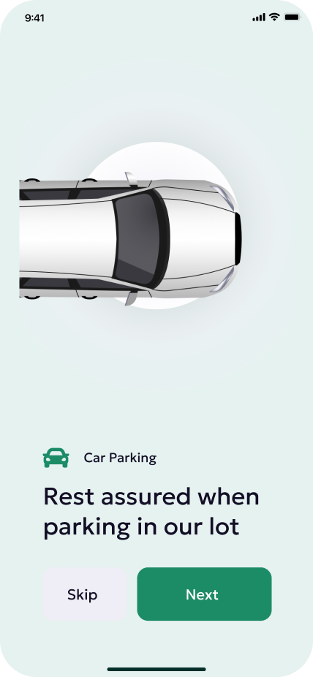
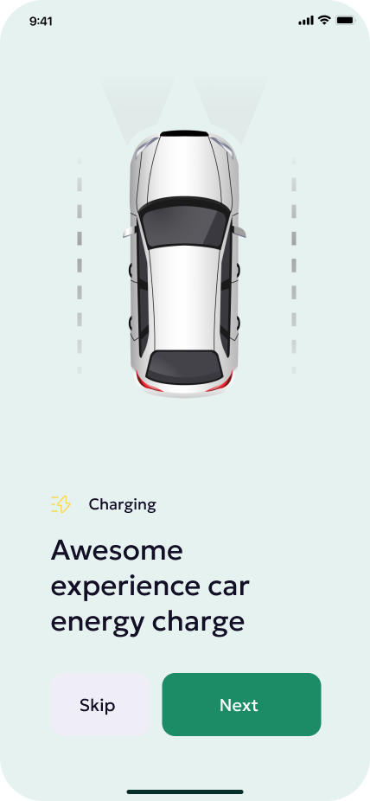
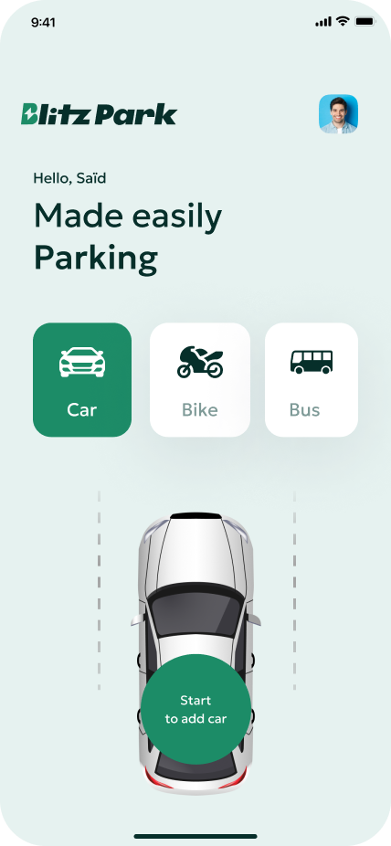
User UI

Slide 25
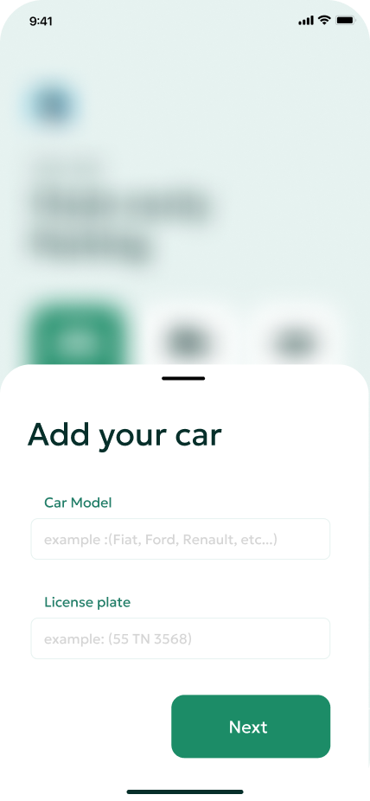
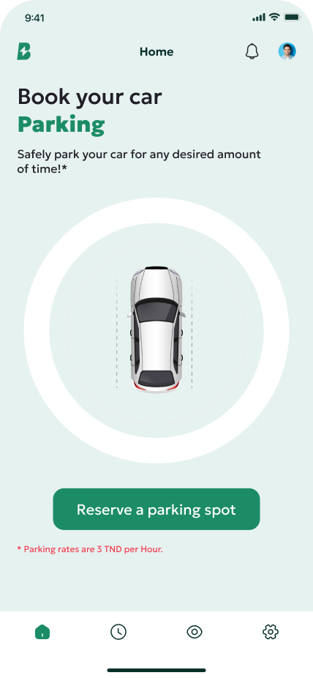
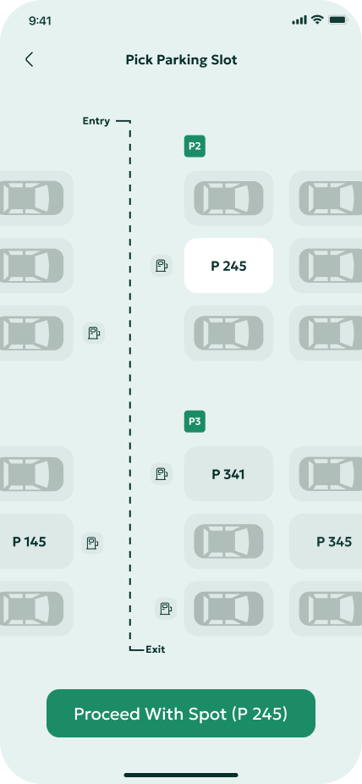
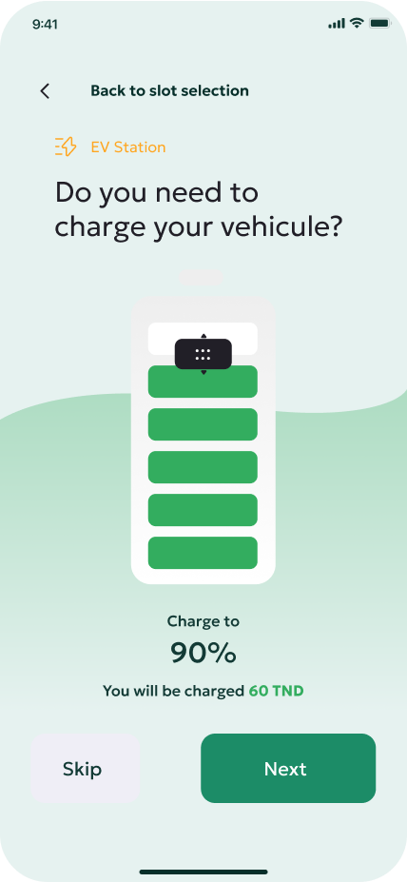
User UI

Slide 26
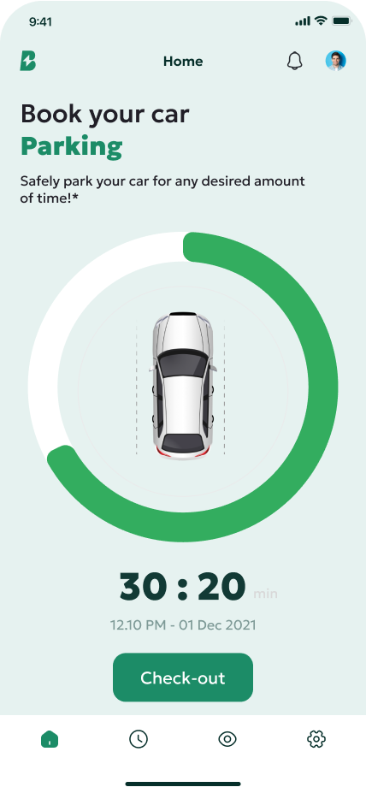
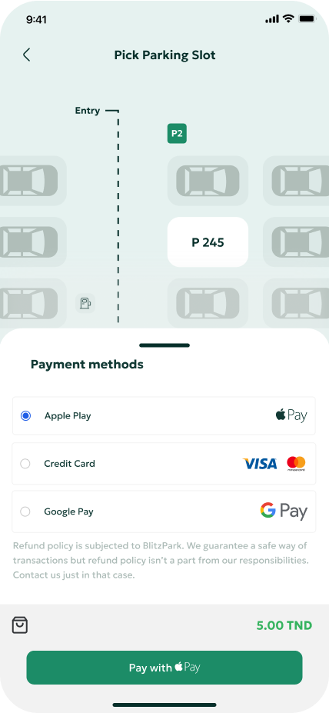
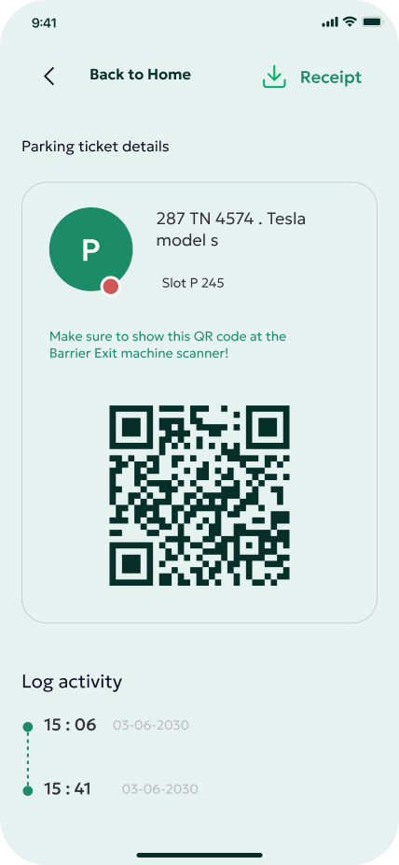
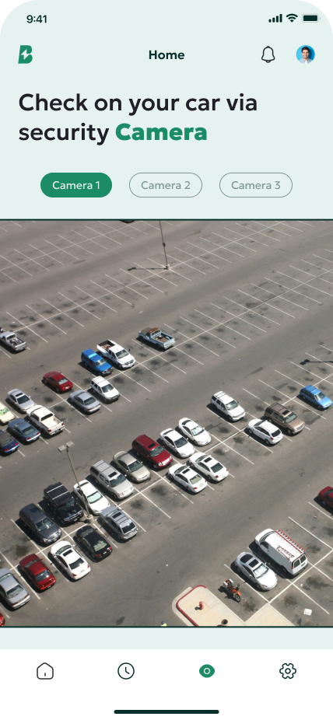
User UI

Slide 27
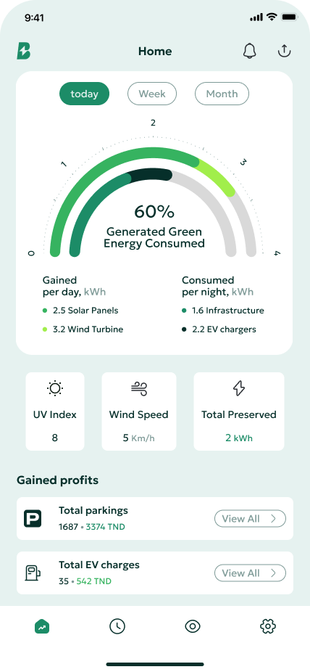
Admin UI

Slide 28
Thank
You

